Slide 1
Windows
Fundamentals

Slide 2
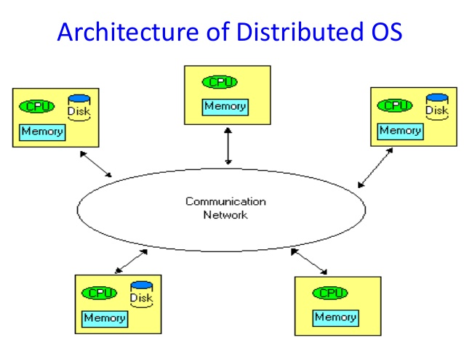
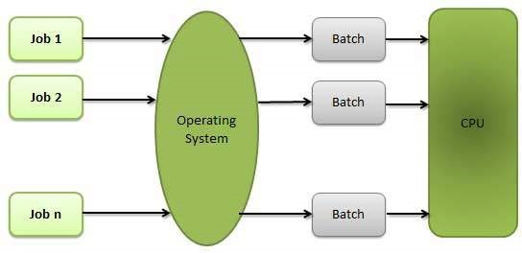
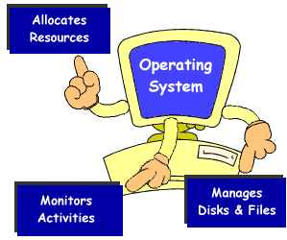
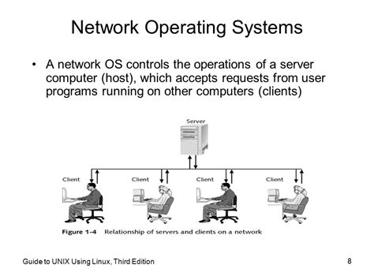
Types Of Operating System
Distributed Operating System
Batch Operating System
Multi Tasking Operating System
Network Operating System

Slide 3
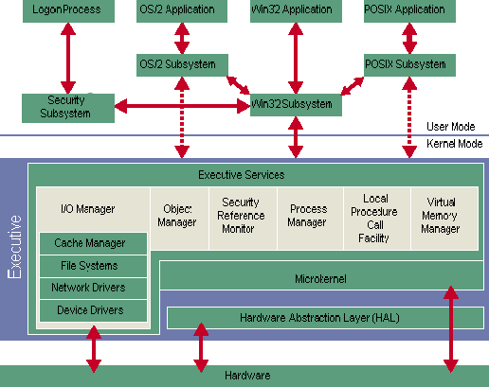
Kernel Architecture
Kernel is the core of the operating system.

Slide 4
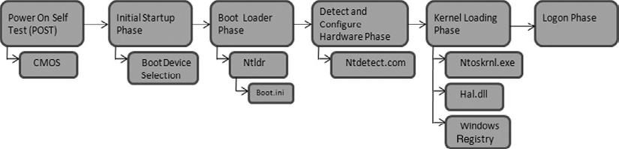
Booting Process

Slide 5
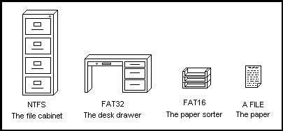
File System
A file is an object on a computer that stores data, information, settings, or commands used with a computer program.
Why we need File System?
Types of File System

Slide 6
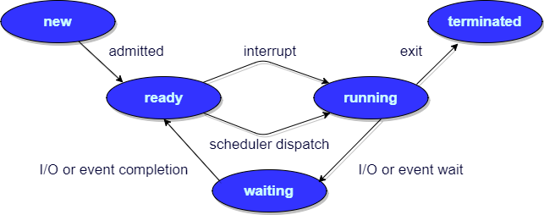
Process Management
What is PCB (Process Control Block) ?
What are the process states

Slide 7
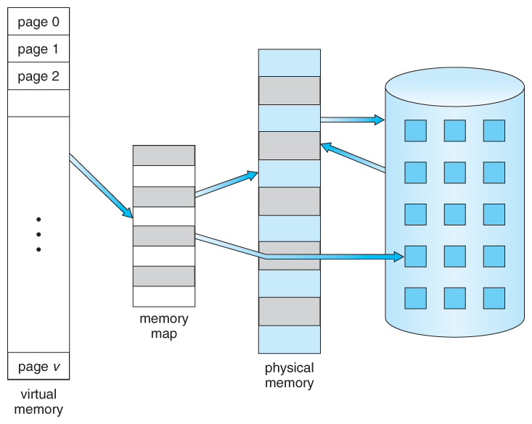
Memory management
What is Paging?
Why we need Paging?
What is Segmentation.
What is Virtual Memory?
What is Thrashing?
HDD
RAM

